Slide 1
DAC Interfacing-8051

Slide 2
Digital to Analog Converter(DAC)
The Digital to Analog converter (DAC) is a device, that is widely used for converting digital pulses to analog signals.
DAC consists of a number of binary inputs(power of 2) and a single output.
DAC0808 – 8 Bit D/A Converter
In DAC 0808, the digital inputs are converted to current(Iout).

Slide 3
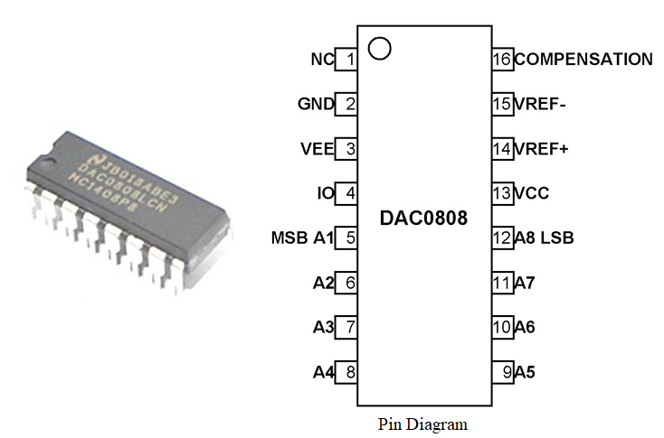
Pin Description of 0808
NC-No connection
GND-Ground
VEE-Negative power supply
IO-Output signal pin
A3-A8:Digital input pins
VCC-Positive power supply
VREF+:Positive reference voltage
VREF-:Negative reference voltage
COMPENSATION
Compensation capacitor pin

Slide 4
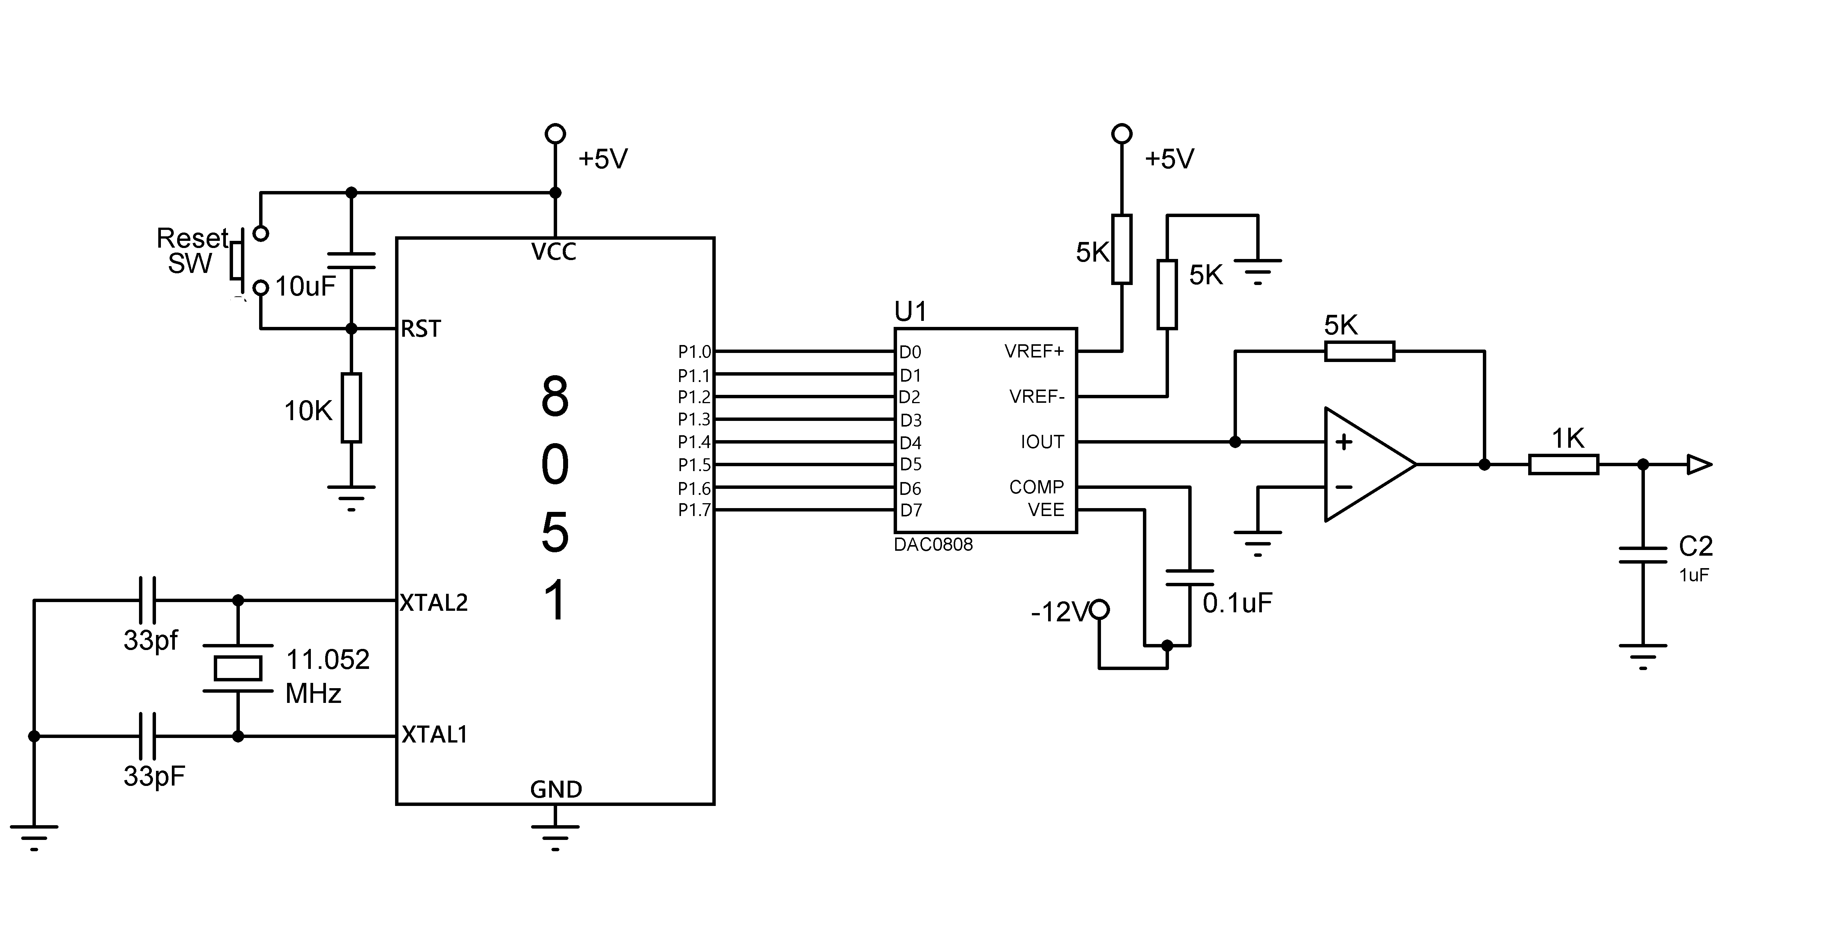

Slide 5

MC1408 DAC (or DAC808) In the MC1408 (DAC0808), the digital inputs are converted to current (Iout), and by connecting a resistor to the Iout pin, we convert the result to voltage. The total current provided by the Iout pin is a function of the binary numbers at the D0-D7 inputs of the DAC0808 and the reference current (Iref), and is as follows:
where D0 is the LSB, D7 is the MSB for the inputs, and Iref is the input current that must be applied to pin 14.

